Slide 1
BFR Algorithm
Point Assignment
BFR (Bradley-Fayyad-Reina) is a variant of k-means designed to handle very large (disk-resident) data sets.
It assumes that clusters are normally distributed around a centroid in a Euclidean space.
Standard deviations in different dimensions may vary.

Slide 2
BFR – (2)
Point Assignment
Points are read one main-memory-full at a time.
Most points from previous memory loads are summarized by simple statistics.
To begin, from the initial load we select the initial k centroids by some sensible approach.

Slide 3
Initialization: k -Means
Point Assignment
Possibilities include:
Take a small random sample and cluster optimally.
Take a sample; pick a random point, and then k – 1 more points, each as far from the previously selected points as possible.

Slide 4
Three Classes of Points
Point Assignment
discard set (DS):
points close enough to a centroid to be summarized.
compressed set (CS):
groups of points that are close together but not close to any centroid.
They are summarized, but not assigned to a cluster.
retained set (RS):
isolated points.

Slide 5
Summarizing Sets of Points
Point Assignment
For each cluster, the discard set is summarized by:
The number of points, N.
The vector SUM, whose i ^{th} component is the sum of the coordinates of the points in the i ^{th} dimension.
The vector SUMSQ, whose i ^{th} component is the sum of squares of coordinates in i ^{th} dimension.

Slide 6
Comments
Point Assignment
2d + 1 values represent any number of points.
d = number of dimensions.
Averages in each dimension (centroid coordinates) can be calculated easily as SUM_{i} /N.
SUM_{i} = i ^{th} component of SUM.

Slide 7
Comments – (2)
Point Assignment
Variance of a cluster’s discard set in dimension i can be computed by: (SUMSQ_{i} /N ) – (SUM_{i} /N )²
And the standard deviation is the square root of that.
The same statistics can represent any compressed set.

Slide 8
“Galaxies” Picture
Point Assignment
Points in
the RS
Compressed sets.
Their points are in
the CS.
A cluster. Its points
are in the DS.
The centroid

Slide 9
Processing a “Memory-Load” of Points
Point Assignment
Find those points that are “sufficiently close” to a cluster centroid; add those points to that cluster and the DS.
Use any main-memory clustering algorithm to cluster the remaining points and the old RS.
Clusters go to the CS; outlying points to the RS.

Slide 10
Processing – (2)
Point Assignment
Adjust statistics of the clusters to account for the new points.
Add N’s, SUM’s, SUMSQ’s.
Consider merging compressed sets in the CS.
If this is the last round, merge all compressed sets in the CS and all RS points into their nearest cluster.

Slide 11
A Few Details . . .
Point Assignment
How do we decide if a point is “close enough” to a cluster that we will add the point to that cluster?
How do we decide whether two compressed sets deserve to be combined into one?

Slide 12
How Close is Close Enough?
Point Assignment
We need a way to decide whether to put a new point into a cluster.
BFR suggest two ways:
The Mahalanobis distance is less than a threshold.
Low likelihood of the currently nearest centroid changing.

Slide 13
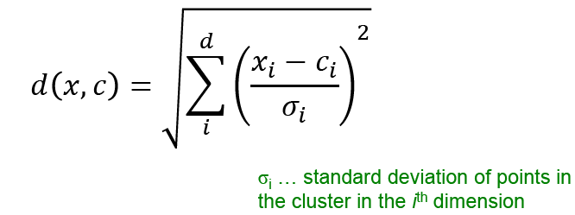
Mahalanobis Distance
Point Assignment
Normalized Euclidean distance from centroid.
For point (x₁,…,x_{d}) and centroid (c₁,…,c_{d}):
Normalize in each dimension: y_{i} = (x_{i} -c_{i})/σ_{i}
Take sum of the squares of the y_{i} ’s.
Take the square root.

Slide 14

Mahalanobis Distance – (2)
Point Assignment
If clusters are normally distributed in d dimensions, then after transformation, one standard deviation = .
I.e., 70% of the points of the cluster will have a Mahalanobis distance < .
Accept a point for a cluster if its M.D. is < some threshold, e.g. 4 standard deviations.

Slide 15
Picture: Equal M.D. Regions
Point Assignment
2σ
σ

Slide 16
Should Two CS Subclusters Be Combined?
Point Assignment
Compute the variance of the combined subcluster.
N, SUM, and SUMSQ allow us to make that calculation quickly.
Combine if the variance is below some threshold.
Many alternatives: treat dimensions differently, consider density.

Slide 17
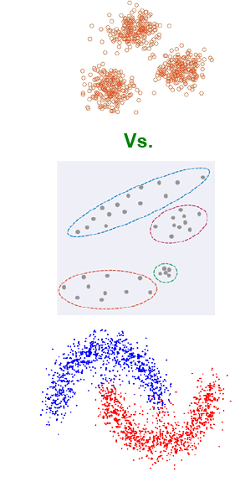
The CURE Algorithm
Point Assignment
Problem with BFR/k -means:
Assumes clusters are normally distributed in each dimension.
And axes are fixed – ellipses at an angle are not OK.
CURE (Clustering Using REpresentatives):
Assumes a Euclidean distance.
Allows clusters to assume any shape.

Slide 18
Example: Stanford Faculty Salaries
Point Assignment
h
h
h
e
e
e
h
e
e
e
h
e
e
e
e
h
salary
e
h
h
h
h
h
h
h
age

Slide 19
Starting CURE
Point Assignment
Pick a random sample of points that fit in main memory.
Cluster these points hierarchically – group nearest points/clusters.
For each cluster, pick a sample of points, as dispersed as possible.
From the sample, pick representatives by moving them (say) 20% toward the centroid of the cluster.

Slide 20
Example: Initial Clusters
Point Assignment
h
h
h
e
e
e
h
e
e
e
h
e
e
e
e
h
salary
e
h
h
h
h
h
h
h
age

Slide 21
Example: Pick Dispersed Points
Point Assignment
h
h
h
e
e
e
h
e
e
e
h
e
e
e
e
h
salary
e
Pick (say) 4
remote points
for each
cluster.
h
h
h
h
h
h
h
age

Slide 22
Example: Pick Dispersed Points
Point Assignment
h
h
h
e
e
e
h
e
e
e
h
e
e
e
e
h
salary
e
Move points
(say) 20%
toward the
centroid.
h
h
h
h
h
h
h
age

Slide 23
Finishing CURE
Point Assignment
Now, visit each point p in the data set.
Place it in the “closest cluster.”
Normal definition of “closest”: that cluster with the closest (to p ) among all the sample points of all the clusters.

Slide 24
Outline
Introduction
Hierarchical Clustering
Point Assignment based Clustering
Evaluation

Slide 25
What Is A Good Clustering?
Evaluation
Internal criterion: A good clustering will produce high quality clusters in which:
the intra-class (that is, intra-cluster) similarity is high
the inter-class similarity is low
The measured quality of a clustering depends on both the point representation and the similarity measure used

Slide 26
External criteria for clustering quality
Evaluation
Quality measured by its ability to discover some or all of the hidden patterns or latent classes in gold standard data
Assesses a clustering with respect to ground truth … requires labeled data
Assume documents with C gold standard classes, while our clustering algorithms produce K clusters, ω₁, ω₂, …, ω_{K} with n_{i} members.

Slide 27
External Evaluation of Cluster Quality
Evaluation
Simple measure: purity, the ratio between the dominant class in the cluster π_{i} and the size of cluster ω_{i}
Biased because having n clusters maximizes purity
Others are entropy of classes in clusters (or mutual information between classes and clusters)

Slide 28
Purity example
Evaluation
• •
• •
• •
• •
• •
• •
• •
• •
•
Cluster I
Cluster II
Cluster III
Cluster I: Purity = 1/6 (max(5, 1, 0)) = 5/6
Cluster II: Purity = 1/6 (max(1, 4, 1)) = 4/6
Cluster III: Purity = 1/5 (max(2, 0, 3)) = 3/5

Slide 29
Rand Index measures between pair decisions. Here RI = 0.68
Evaluation
Number of points | Same Cluster in clustering | Different Clusters in clustering
Same class in ground truth | A=20 | C=24
Different classes in ground truth | B=20 | D=72

Slide 30
Rand index and Cluster F-measure
Evaluation
Compare with standard Precision and Recall:
People also define and use a cluster F-measure, which is probably a better measure.

Slide 31
Final word and resources
In clustering, clusters are inferred from the data without human input (unsupervised learning)
However, in practice, it’s a bit less clear: there are many ways of influencing the outcome of clustering: number of clusters, similarity measure, representation of points, . . .

Slide 32
More Information
Christopher D. Manning, Prabhakar Raghavan, and Hinrich Schütze. Introduction to Information Retrieval. Cambridge University Press, 2008.
Chapter 16, 17

Slide 33
Acknowledgement
Slides are from
Prof. Jeffrey D. Ullman
Dr. Anand Rajaraman
Dr. Jure Leskovec
Prof. Christopher D. Manning

